Slide 1
Objectives
The objectives of these topics are to provide information about
Creating a New Document
Saving a Document
Opening a Document
Opening Multiple Documents
Typing Text

Slide 2
Screen Layout
Default screen layout is the layout of MS word when it is opened. We can change the default layout according to our will.
In title bar, Name of the document with “Microsoft word” is written. If it’s a new document and not being saved yet, it will have temporary name like Document1, Document2 etc.
A file created by word processing software is called document.

Slide 3
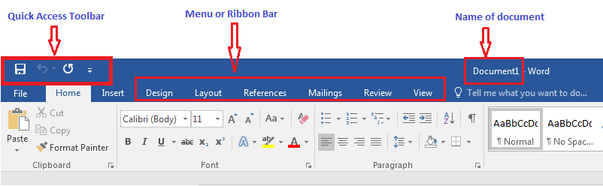
Screen Layout

Slide 4
Screen Layout
Menu bar or ribbon bar is a bar just below the title bar of the document. It contains Sub menus (File, Edit, View etc.) to give specific instructions to word processor.
For example, File menu contains commands like Save, Close, Exit for the open document.
Edit menu contains editing related commands like cut, copy, paste for the text of word document.

Slide 5
Different Toolbars
At the Upper right side of the title bar, you can see three buttons
1- Minimize button – This button is used to minimize (An open window will appear as icon in task bar) the word document. To maximize this window, click on its icon at the taskbar.
2- Restore down button – This button is used to restore down the window to a smaller size on desktop.
3- Close button – This button is used to close the document.

Slide 6
Scroll Bars and Rulers
Scroll Bar
At the Right side and at the bottom of the Document There is Scroll bar.
With the Right vertical scroll bar Document can be scrolled up and down.
With the Bottom Horizontal Scroll bar we can scroll document left or right.

Slide 7
Rulers
Rulers are at the left side and on the upper side of the document.
Upper Ruler shows the starting and ending of a line in the document.
Left Rulers shows the starting and ending of the document.
Rulers can also be adjusted as per our need.
At the extreme bottom of the document status bar can be found. Status contains information about on which page we are right now how many words are present in the document.

Slide 8
Opening a New Document
To create a new document in Microsoft word from File menu we click on New and after that we select Blank Document.
From Keyboard we can use shortcut key CRTL + N to create new Document.

Slide 9
Opening an existing Document
A document which was previously created can also be opened from File menu, click on the File then Open and from the file dialog box select the document of your choice and click open.
From Keyboard we can use shortcut key CRTL+ O to open a previously created document.

Slide 10
Typing Some Text
Text can be added on the Document white Blank area. Blinking Vertical line ‘|’can be found on the screen this is called cursor.
Cursor shows the position of the text which will be entered next. Mostly this cursor is to right of the last word entered.

Slide 11
Saving
A Document can be saved in the computer hard disk for the later use, we can save document with some methods.
First method is to click on the save button from Quick Access Toolbar.
Second Method is from File Menu we can click on save Button.
Third Method is to Crtl + S From Keyboard.
After Clicking save from any of the above button a dialog will be opened, we can select the destination folder from there, and chose a name for our document and click the button save our document will be saved.

Slide 12
Opening Editing and Saving Again
We can open a file from File menu or by pressing short cut key CRTL+ O .
Open file menu contains much option to organize, select and open a particular word document.
From the file types we can select different file types to display in the file menu.

Slide 13
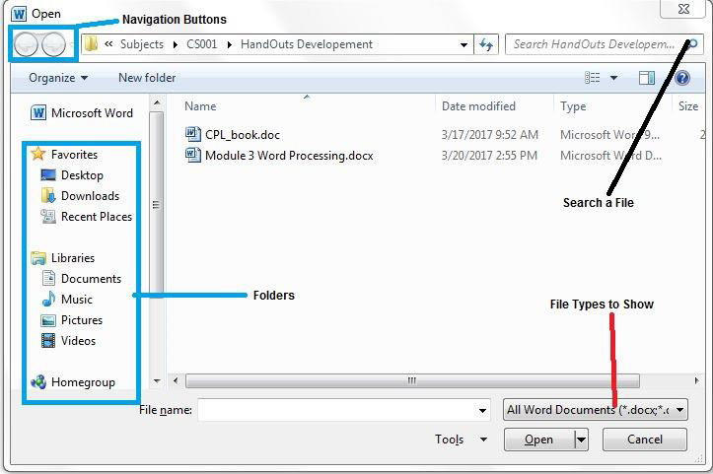
Opening Editing and Saving Again

Slide 14
Opening Multiple Documents Simultaneously
In Real life we require more than one document at the same time. Microsoft Word Provides same functionality of opening and working with multiple documents simultaneously.
To open Multiple Documents at the same time we simply navigate to target folder and double click on the document file(s).
To switch between multiple documents, we simply use short key ALT+TAB.

Slide 15
Saving an Already saved Document
A document which has already been created and saved to a location can also be saved to another location for example USB drive.
To save a document to another location we use save as feature of Microsoft Word, first we navigate to File Menu then from file menu we will select Save As Option a new window will be opened, from this opened window we can select the destination folder and click the save button to save the document to new destination.
Remember after saving the file with save as feature will not remove the document from the previous folder, it will just make another copy of that document into new folder.

Slide 16
Getting Help from Microsoft Office
Help from Microsoft Word can be get in case someone cannot understand how to perform certain task.
To get help from MS Word we use help button at the upper right corner of the screen.
Or shortcut key F1 from keyboard can be used.

Slide 17
Closing a single document and closing Word
To close a single document in MS Word from the File Menu select close option to close a single document.
To close the Microsoft word application, click the cross button at upper right corner or press shortcut key from keyboard ALT+F4.

Slide 18
Thanks

